Slide 1


Project B:
Bodywatch
X

Slide 2
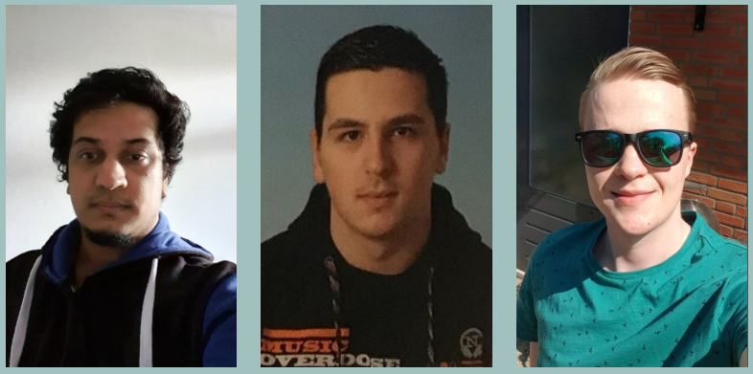
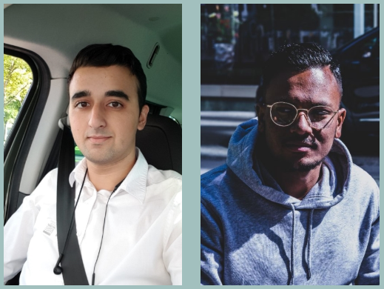

Introduction: Who are we?
Hogeschool Rotterdam
Notes:
Welcome to our presentation. We are 5 students from Rotterdam university of applied science, and all study computer science or technical computer science. During this pitch we would like to tell you more about the progress of our project.

Slide 3

Purpose of the presentation
Notes:
Schoolproject
Voortgang bespreken
The goal for this presentation is to show you our progress, that we made and to show you our working proof of concept. We are also going to discuss our advantages over other market solutions.

Slide 4
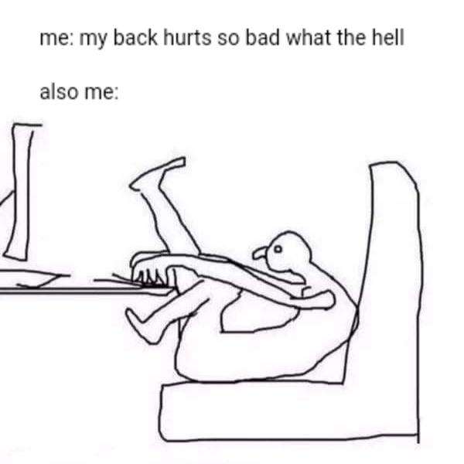
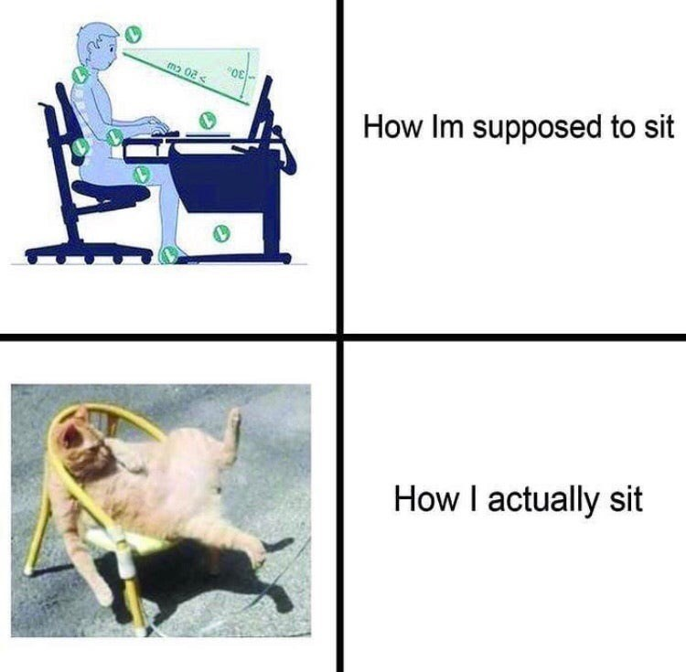
What is the issue?
Notes:
Have you ever thought about how long you spend at your computer every day? And do you recognize the feeling that you were so deep in a project that you increasingly crawled into your laptop?
And certainly now we see that because of Corona there are many more people behind their computers for a long time. And you see that people are connecting with their laptops to the internet. You also see that An office worker can easily sit behind a computer for six hours at a time

Slide 5
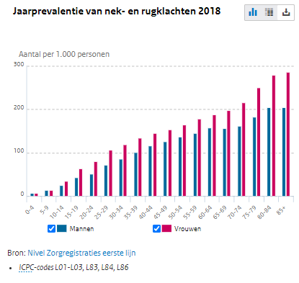
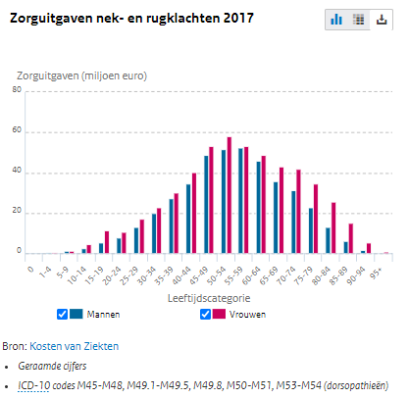
Why is it an issue?
Notes:
Mensen hebben pijn
Kost heel veel geld
Zorgkosten
Productiviteit verlies
But now I see you thinking, why is this a problem?
If you sit behind your laptop for a long time with the wrong posture, you can develop chronic neck and back problems. If you notice that you are developing these complaints, it is often too late. The Ministry of Health therefore lists incorrect posture as one of the four main reasons for back and neck complaints. They also measured that in 2017, more than two million Dutch people had back problems.
In 2017 alone, 937 million euros was spent on medical care for neck and back complaints. You also see that the target group that incurs the most costs is 45 to 64 years old. People often work in this phase of life.
Not only is there medical spending research by RIVM also shows that people are less productive. This results in a lot of cost due to lost productivity.

Slide 6
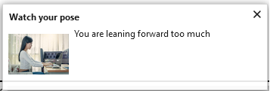
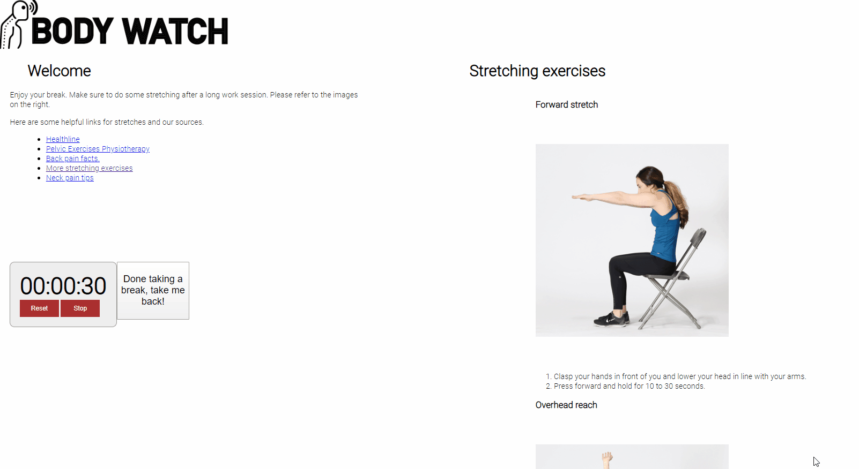
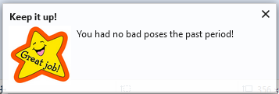
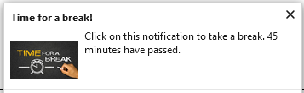
OUR SOLUTION
Your personal coach
Notes:
Over onze oplossing praten ‘we adviseren’ met stretches, notificaties bad pose.
We zijn eigenlijk je assistent
We helpen je bewust worden van momenten van slechte postuur
We helpen je met pauzes nemen
We have made a personal assistant that watches your posture. It detects wrong posture behind your computer and notifies you. We have researched the most effective methods to notify the user. We conducted our research with interviews, enquetes and feedback buttons in our prototype.

Slide 7
Benefits of our
solution!
Low Cost
Live feedback
Learning
No expensive hardware required
Get live feedback through notifications and reminders
Make it a habit of keeping a good posture
Notes:
No expensive hardware required, low cost investment
Widely applicable in real office
Live feedback
Smart Reset Timers
Teaches a good posture

Slide 8
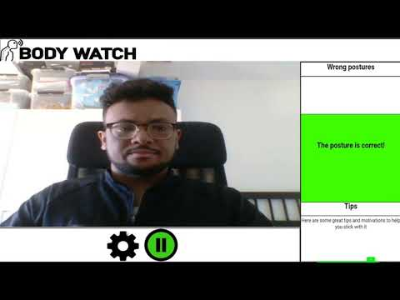

PRODUCT DEMO

Slide 9
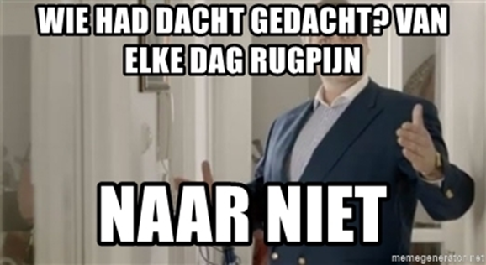
Summary
Notes:
Probleem->corona
Doelstelling=probleem voorkomen
Oplossing-> hoe maken maken we deze oplossing
Voordelen

Slide 10
You can try our program
www.project-bodywatch.nl

Slide 11

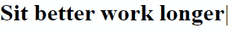
End Note
Want to try it yourself? Or want to read the slideshow again? Visit: www.project-bodywatch.nl
linkedin.com/in/gregory-kaman-492b41182
linkedin.com/in/pranawa-somvedi-02076273
linkedin.com/in/Diderickm
linkedin.com/in/canberk-ates-a46922178/
linkedin.com/in/bilal-azrioual-17b721151/
Notes:
Slagzin
linkedin
Website
Zelf uitproberen
Waar kan ik de powerpoint teruglezen?
NOG LINK NAAR VIDEO / POWERPOINT OP SITE PLAATSTEN

